Slide 1


Project Title : (Secure Mailbox)
Developed By
Md. Mazharul Islam
ID: 171-35-1798
Department of Software Engineering
Faculty of Science and Information Technology
Daffodil International University
Supervised By
Ms. Afsana Begum
Assistant Professor
Department of Software Engineering
Faculty of Science and Information Technology
Daffodil International University

Slide 2
Project Requirements
Secure Mailbox is a web based and cross platform supported application. Where user and admin play main role in whole project.
User features :
Admin Features :
Registration
Log-In
Password Recovery
View Email List(Sent/Receive)
Send Mail
Encrypt and Decrypt File
Live Chat
View Notification List
Log In
Password Recovery
View User List
Create Update Alert!

Slide 3
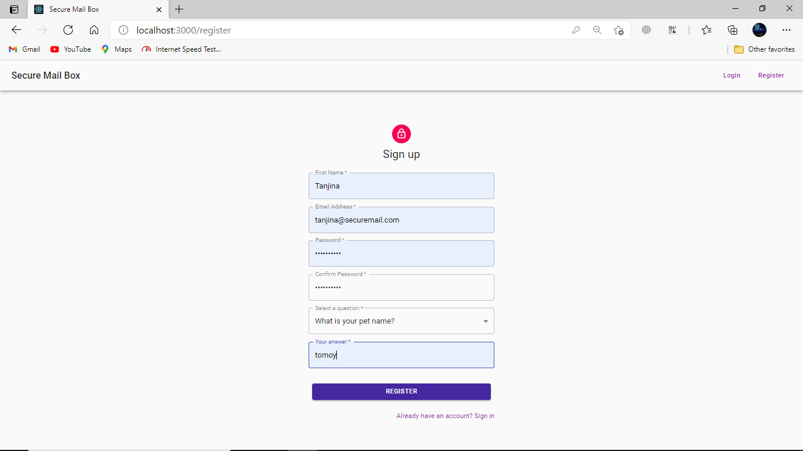
Project Outcome
User Features
Registration :

Slide 4
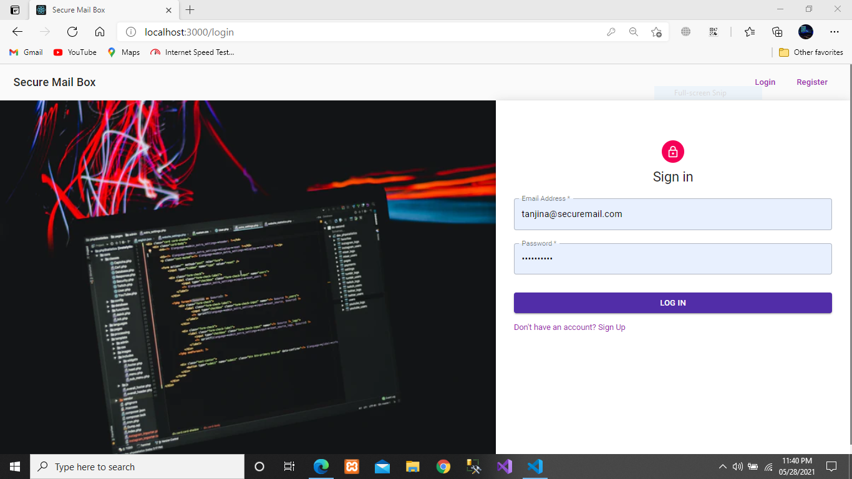
Log-In :

Slide 5
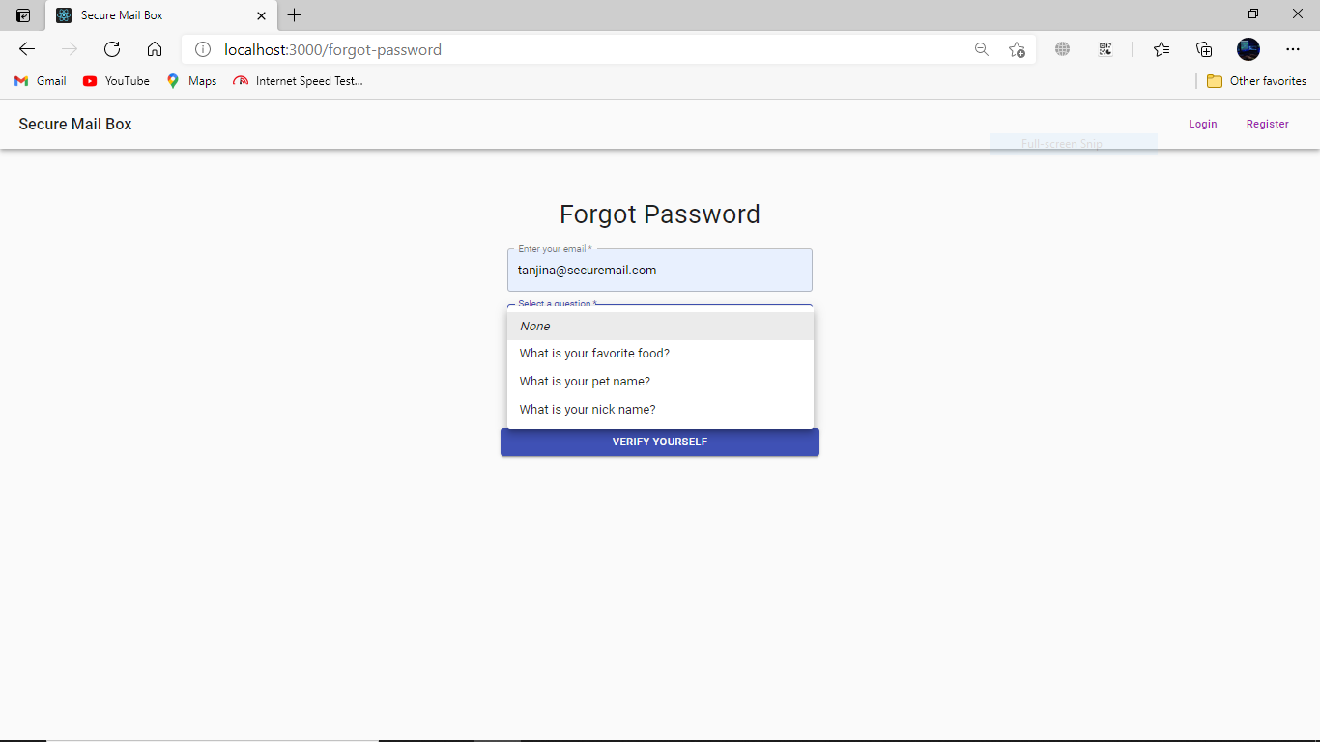
Password Recovery :

Slide 6
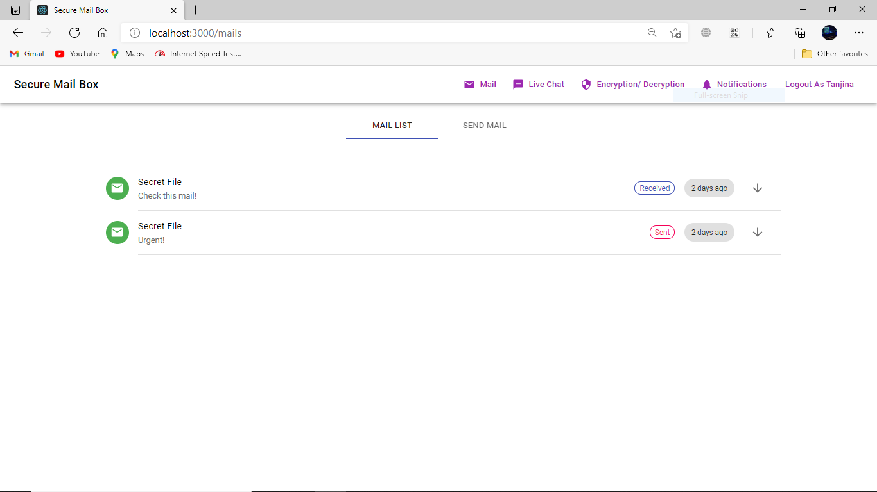
View Mail-list :

Slide 7
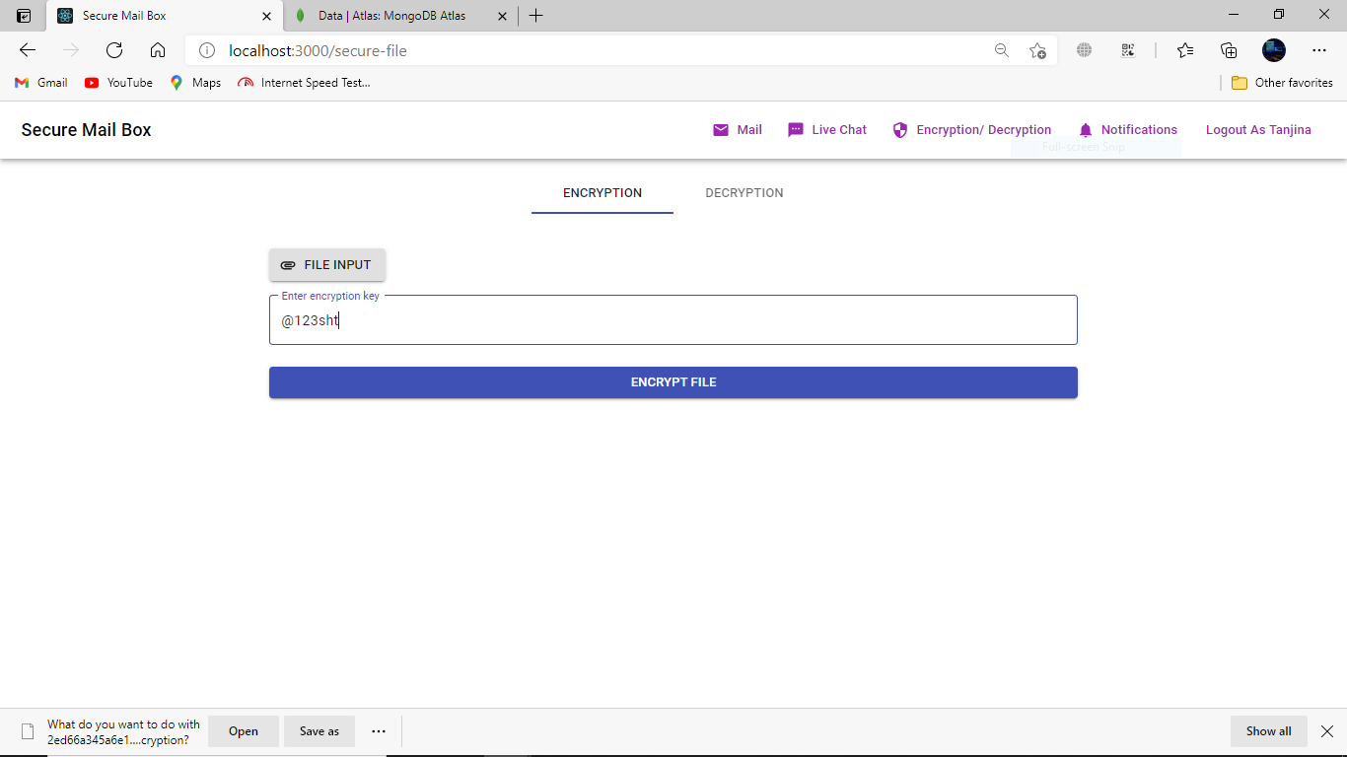
Encrypt File :

Slide 8
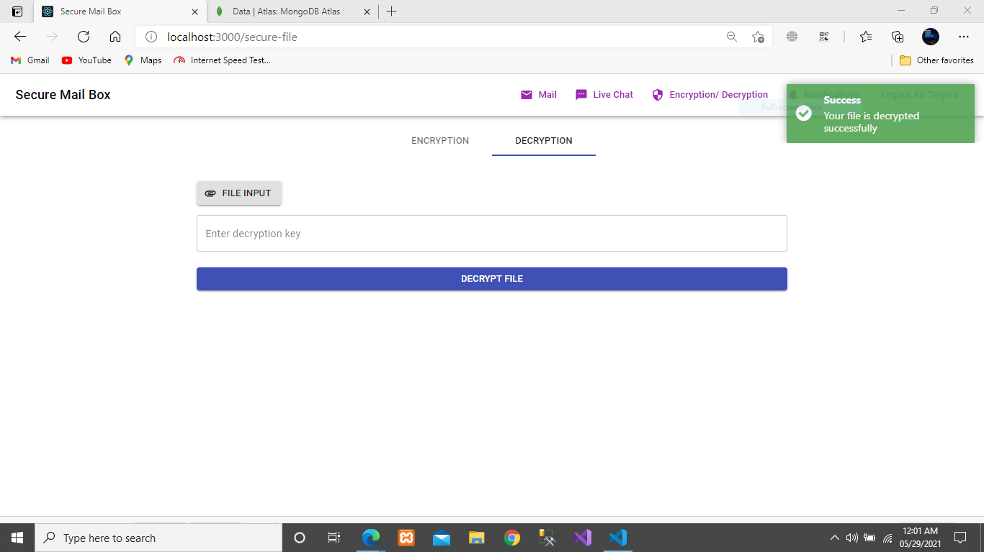
Decrypt File :

Slide 9
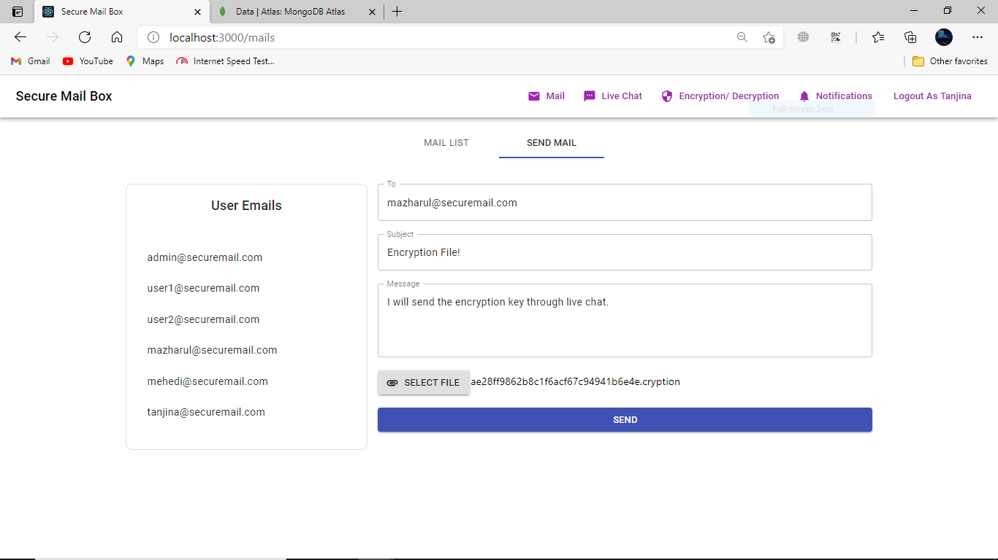
Send Mail :

Slide 10
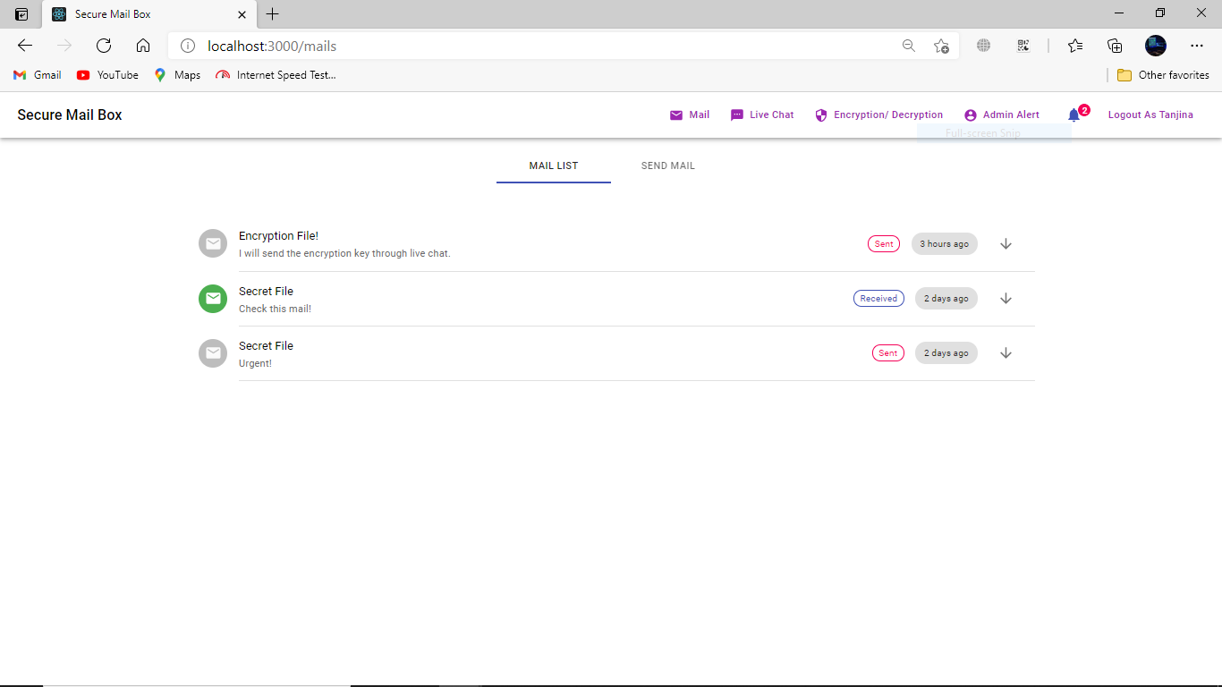
View Notification List :

Slide 11
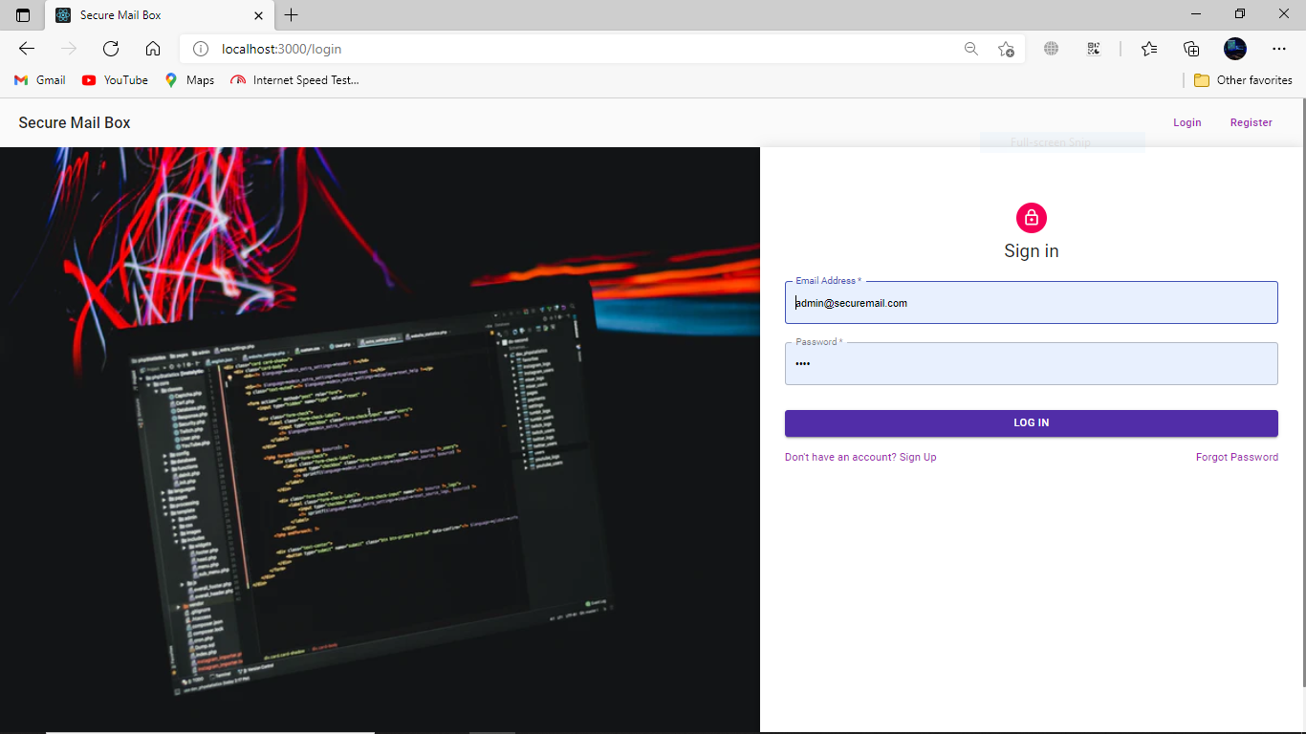
Admin Features
Log-In :

Slide 12
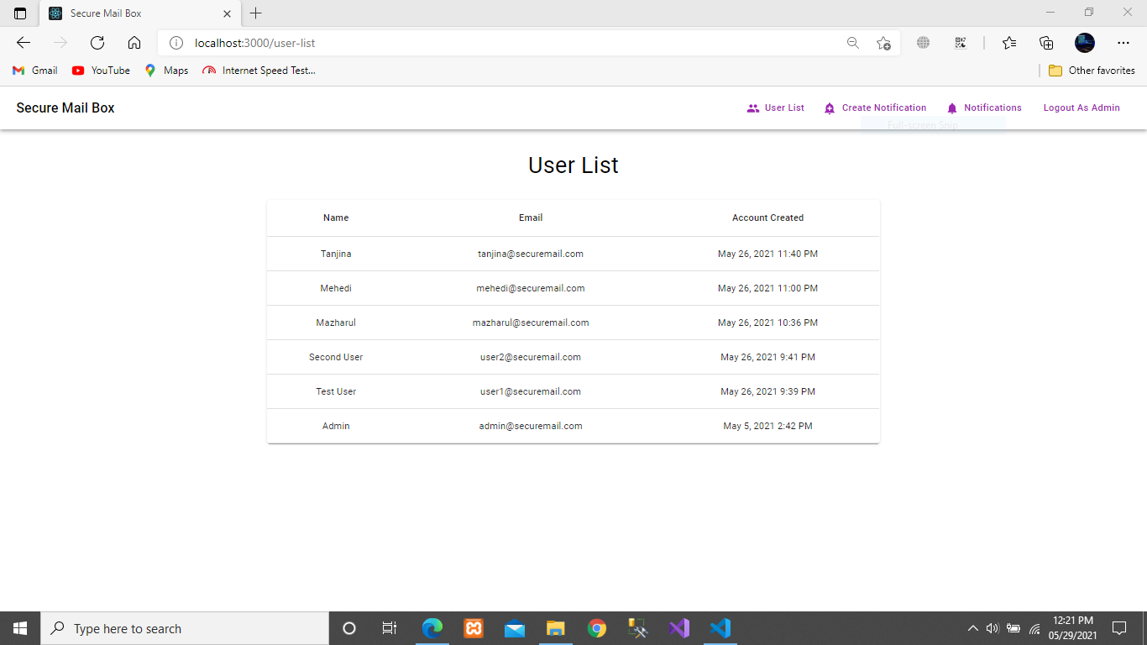
View User List :

Slide 13
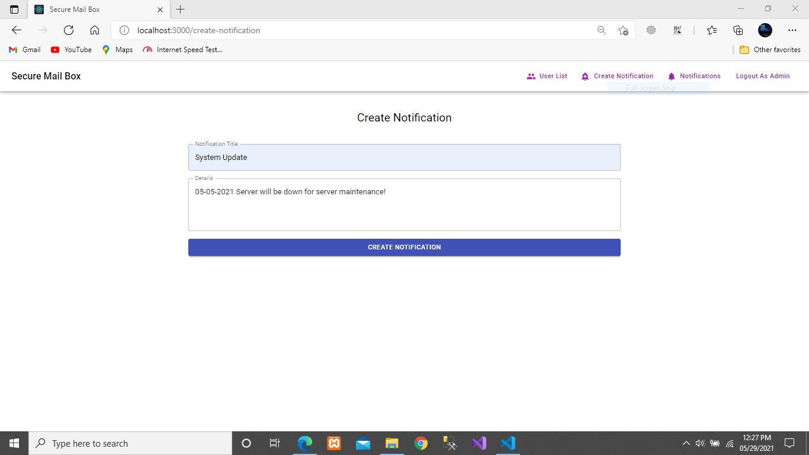
Create Update Alert :

Slide 15
END

